Slide 1
CS155 Final Project
By Kostyantyn Shumishyn

Slide 2
Goal
Make a game that had comparable gameplay to that of the old classic “Rogue”.
Intended Features:
- Traversing a Dungeon
- Finding items and picking them up
- Destroying enemies by attacking them

Slide 3
Accomplishments
Reality:
- Glitchy Collision
- No enemies and a useless HP Stat
- Created a Proton Accelerator that shoots faster every time the firing button is pressed (IT’S A FEATURE).
- Can change between Fullscreen and not

Slide 4
Challenges
Learning a new Open Source Library from a deprecated Graphics Library.
Learning how to Draw each object and keep them updated.
Troubleshooting things not rendering
Creating Collision and debugging it to prevent entering collide-able objects with clever keystrokes.
Dealing with Vectors and understanding movement.

Slide 5
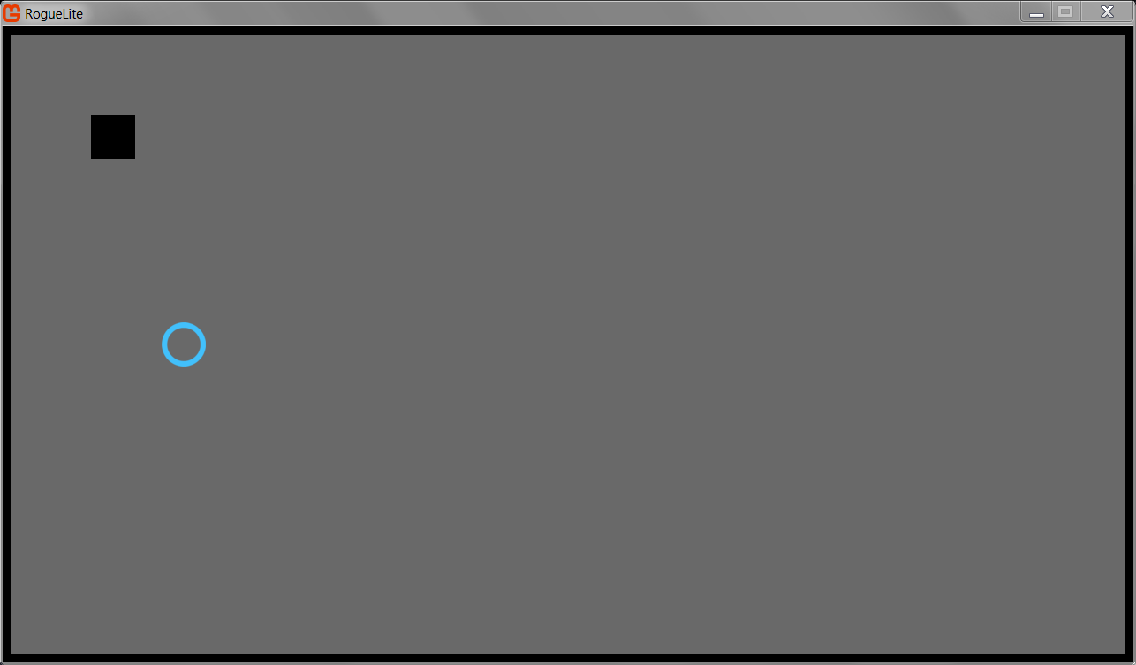
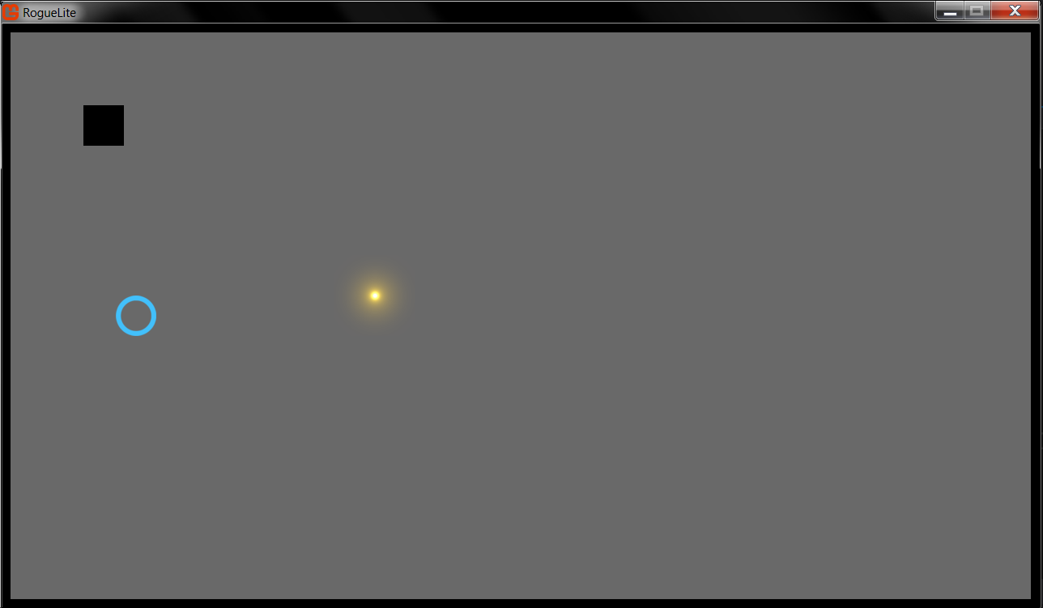
Demonstration
(Spoiler: it sucks)

Slide 6
Thanks for Listening!

